Slide 1
Customer insights through the LinkedIn APIs
Proposal
David Stevens & Gilberto Come

Slide 2
Introduction
In a world of Opendata, it has become increasingly easy to gain insights on many aspects of our customers demands; from generic market demand signals to detailed investor and strategy whitepapers for an individual client.
LinkedIn provide a number data\API services within their platform; from consumer services such as “sign in with your LinkedIn profile” to marketing and sales datasets. The LinkedIn marketing data and API services allow any approved user the ability query and capture key insights about an organisation.
Our proposal is to retrieve the available information from DXC existing and potential customer base and combine this with the capabilities within DXC’s Digital Explorer platform to build a rich, self service portal for account and sales executives to gain relevant insights for their customers at zero cost.

Slide 3
LinkedIn Organisation
Any approved application/API service registered on LinkedIn can query the Organisation dataset; We are proposing to capture the following information for a list of managed organisations
Field | Description
description | Description for the entity.
industries | The industries associated with the entity.
localizedDescription | The locale-specific description of the entity.
localizedName | The locale-specific name of the entity.
Locations | List of locations for the entity.
name | Entity's name.
parentRelationship. parent | ID (URN) of the parent organization.
parentRelationship. organizationRelationshipType | Type of relationship from child to parent organizations.
parentRelationship. relationshipStatus | The status of a relationship between organizations.
Website | Entity's website.
staffCountRange | Range of the number of staff associated with this entity
organizationStatus | Status of the organization, such as operating or out of business.
organizationType | Type of organization.

Slide 4

Connecting to DXC Knowledge Graph
The retrieved information will be added to DXC Digital Explorer Knowledge Graph and connected/enrich at the following points
Industries Connected to DXC industry Business Value Framework
Key trends
Analyse `description` text to map to business and technology trends

Slide 5
Implementation Use Cases
Embedded within Digital Explorer
Customer information retrieved/refreshed and presented on demand within Digital Explorer Workgroups (DXC employee restricted)
Open Graph Navigator to explore/reveal similarity between customers. (DXC employee restricted)
DXC Open Knowledge Graph
Information available to any DXC Team (e.g. Competitive Intelligence) via DXC OpenAPI’s for inclusion in PowerBI and other reporting applications via controlled (Global Pass) Tokens
Connect sales campaigns to customer of a given size and growth rate.

Slide 6
Security and Access Controls
The LinkedIn Application will be registered under the DXC organisation group on LinkedIn and access given to named individuals (controlled by DXC LinkedIn administration team)
Retrieved information will be stored within DXC Digital Explorer graph and presented to DXC Employees only

Slide 7
Costs
API run costs are zero ~ there are limits on the number of calls, but our planned usage pattern wouldn’t hit these.
Development effort 2 sprints from Digital Explorer development team (approx. 4 weeks)
Operational cost should be close to zero, but would require maintenance if the LinkedIn API changes

Slide 8
Constraints
DXC Customer register/master list matches organisations public name on LinkedIn
Workaround is to build/manage a look-up table (AGM/Account maintained)
Data is owned/controlled by the external organisation, data quality still to be proven.

Slide 9
Sponsors/Stakeholders/Approvals
 | Sponsor | Stakeholder | Approver
Ken Corless | X | X
Rich Reba | X | X
HaeJin Higgins |  | X | X
Jessica Wallace |  | X | X

Slide 10
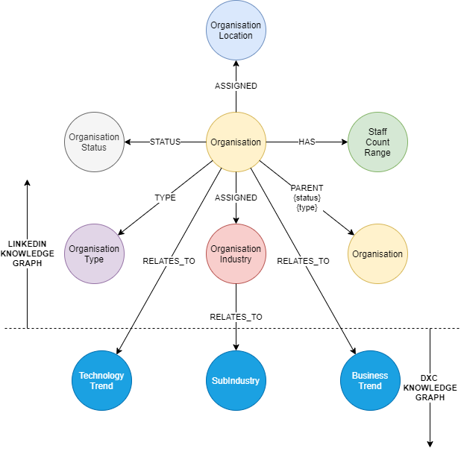
DE/LinkedIn Graph Model
Would include a timestamp to track changes
Initial Graph Model

Slide 11
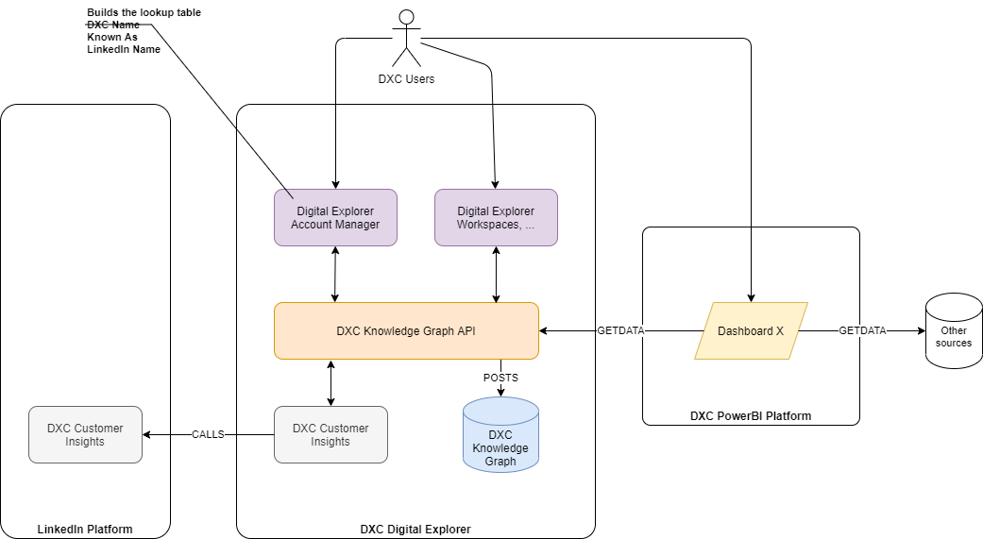
Proposed Architecture

Slide 12
Enabling the API
A new LinkedIn development application is created (by any LinkedIn user)
Application is associated to a known Organisation (DXC Technology)
DXC technology organisation administrators review and approve application
Once approved
Application owner can add LinkedIn “Products”
Application owner adds “Organisation Product” to their application
DXC administration team review and approve
If required LinkedIn approval request created by application owner
Once approved
Application can request API tokens for organisation products
References
LinkedIn Developers
API documentation

